Slide 1
Welcome!
Nursing Program Information Session
Amanda Bevington Drungil, EdD
Assistant Director of Admissions & Records

Slide 2
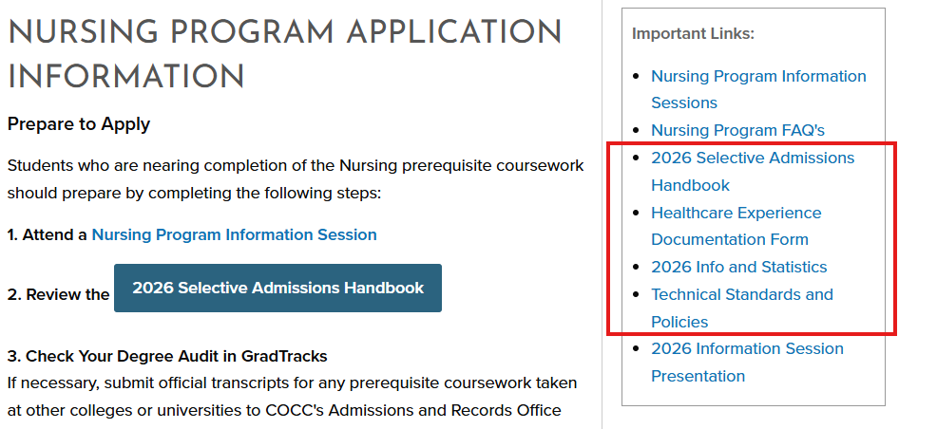
WHILE YOU WAIT…
Download the following documents:
  Selective Admissions Handbook
  Healthcare Experience Form
  Info and Stats Sheet
  Tech Standards and Policies
Search ‘Nursing Program Application’ in COCC webpage search bar, choose the first option to appear on the search list, and then you will see the links to download
Notes:
Link for chat: https://cocc.edu/programs/nursing/nursing-program-application-information

Slide 3
Associate of Applied Science in Nursing

Slide 4
AGENDA
Program Overview
Eligibility Requirements
Point Criteria and Application Evaluation
What’s Next / Back-up Plan
Questions and Answers

Slide 5
PROGRAM OVERVIEW
Pre-nursing preparation is approximately 1 – 2 years (pre-requisites and support courses).
Nursing Program Summary (2 years):
  LPN (first year) → Certificate of Completion
  RN (second year) → Associates in Applied Science
  Exit point after LPN year*
*Readmission, Advanced Placement, and Transfer Pathways are available, but seats/space is limited.

Slide 6

APPLICATION ELIGIBILITY
Requirements
The nursing program is a cohort model program (starts in Fall only), and admissions is competitive and enrollment is limited.
  Application opens March 1, 2026 and the link to apply will be located on the Nursing Registration Information webpage. The deadline is 5pm on May 1, 2026.
Spring term courses are counted toward application requirements. See back page of handbook if transferring credits in from another institution.
Must submit a general application to COCC and submit official transcripts (if any) before applying.
All requirements (outside of current In Progress courses) must be complete by close of
application deadline (no exceptions).

Slide 7
APPLICATION ELIGIBILITY
Cohort Options
The COCC Nursing Program will have two cohorts for the Fall 2026 program:
  Bend Cohort will attend classes at the Bend campus (48 seats available annually), and clinicals will be in Bend or possibly Redmond.
  Madras Cohort (8 seats available), and clinicals will be in Jefferson or Crook Counties.
You must designate your cohort selection on your application. You may not change your selection after the application deadline.
  Option 1: Apply for the Bend Cohort only
  Option 2*: Apply for the Madras Cohort only
  Option 3*: Apply for the Bend Cohort first, if not selected, move application to Madras cohort
  Option 4*: Apply for the Madras Cohort first, if not selected, move application to Bend cohort
*Additional residency documentation is required for Priority Admissions for
Madras Campus Cohort.

Slide 8

APPLICATION ELIGIBILITY
Residency Requirement
Bend and Madras Cohort Residency Requirement:
  Must be an “in-district” student by the start of the nursing program.
If you are not already living in-district:
  If they start taking classes as an out-of-district/out-of-state student, Students are considered “out-of-district” for two years.
  Or, students may wait one full year after moving to the area before taking any classes at COCC, then they can apply as an in-district student.
  Applicants may be required to document in-district residency if inconsistencies are noted between the application and student record information.
Refer to district map on COCC’s website.

Slide 9
APPLICATION ELIGIBILITY
Madras Cohort Residency Requirement
Admissions for the Madras Cohort is based on the following priority
Documentation of current residence is required when applying for this cohort – examples include: current utility bills, property tax records, tribal ID, vehicle title or registration card, etc.
    Priority 1*: In-district residents of Jefferson County and in-district residents and members of the Confederated Tribes of Warm Springs.
    Priority 2*: In-district residents of Crook County.
    Priority 3*: All other in-district residents
*No points are awarded for priority groupings. Applicants for the Madras cohort will be organized into three priority groups: Priority group 1 will be ranked and awarded seats first, then Priority group 2 will be ranked and awarded seats (if any are remaining), then Priority group 3 will be ranked and awarded seats (if any are remaining).
Refer to district map on COCC’s website.

Slide 10
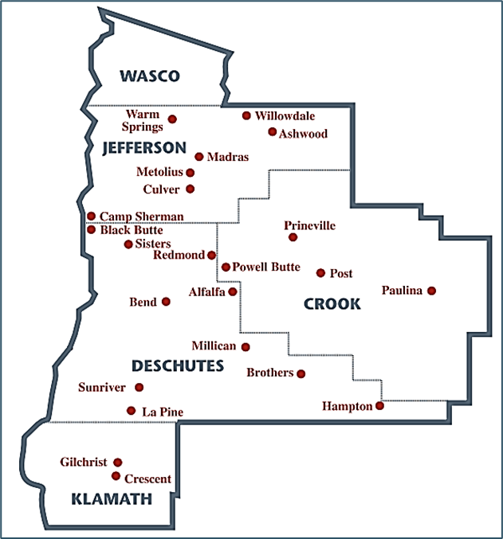
APPLICATION ELIGIBILITY
Residency Map:

Slide 11
APPLICATION ELIGIBILITY
Madras Cohort Notes
The Madras cohort is in person in the Madras classroom but theory classes are facilitated in Bend and so attendance is synchronous and remote.
The Madras cohort skills labs are on site in Madras in the new Madras health careers center (same building as the theory classes) and the clinical experiences are all offered in Madras and Prineville areas.

Slide 12

APPLICATION ELIGIBILITY
Pre-Requisite Course Requirements
Must maintain a 3.0 GPA in these prerequisite courses to apply to the program (only whole grades are used in calculation):
  Anatomy & Physiology 1 (BI 231)*
  Anatomy & Physiology 2 (BI 232)*
  Anatomy & Physiology 3 (BI 233)*
  Microbiology (BI 234)*
  Math in Society (MTH 105/105Z) or a course from the foundational requirements list
  Composition I (WR 121/121Z)
*These course cannot be older than five years: (e.g., Five years from 2026 would be Fall 2021)

Slide 13
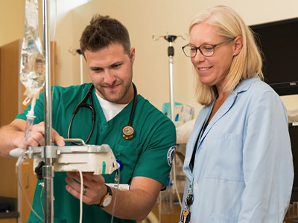
APPLICATION POINTS CRITERIA
Application Points
  Like most nursing program admissions, your application success is dependent on a certain amount of points.
  Point Breakdown:
    Support Courses (30 points maximum)
    HSRT-AD Score (27.5 points maximum)
    ATI TEAS Score (37.5 points maximum)
    Healthcare Experience (5 points maximum)

Slide 14
APPLICATION POINTS CRITERIA
Support Courses (30 points maximum)
Must have a “C” or better in these courses to get points.
  Highly encouraged to take ALL of these courses by the application deadline.
    Human Nutrition (FN 225)
    Composition II or Technical Writing (WR 122/122Z or WR 227/227Z)
    Developmental Psychology (PSY 215)
    Introduction to Chemistry or General Chemistry (CH 104 or CH 221/221Z w/ lab 227Z)*
    Human Relations Requirement (Choose One):
      Intro to Psychology II (PSY202/202Z), Positive Psychology (PSY 228), Intro to Sociology (SOC 201/SOC204Z) or Race, Class, and Gender (SOC 212)
*This course cannot be older than five years (.e.g., Five years from 2026 would be Fall 2021)

Slide 15
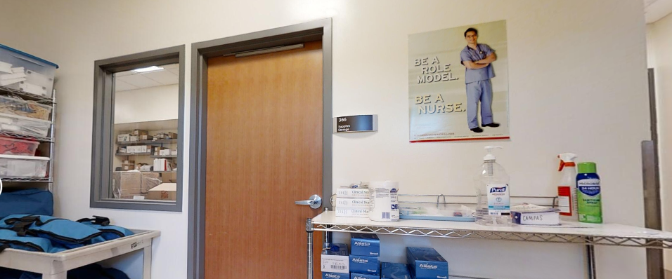
APPLICATION POINTS CRITERIA
Support Courses (30 points maximum)
5 classes = 30 points
4 classes = 24 points
3 classes = 18 points
2 classes = 12points
1 class = 6 points
No classes = 0 points

Slide 16

APPLICATION POINTS CRITERIA
Course Expiration Re-Cap
All of these courses expire after five years:
  Anatomy and Physiology series
  Microbiology
  Chemistry
*Your english, math, psychology, human relations, and nutrition classes do not expire.

Slide 17
APPLICATION POINTS CRITERIA
HSRT-AD Exam – up to 27.5 points:
Health Science Reasoning Test, Associates Degree
  Scenario-based/critical thinking test
  Up to 2 chances before applying to the program for the first time; 1 chance per application year after (application takes highest score of all attempts) tests taken before your first application year will count toward your two total attempts.
    Must be taken at COCC – seats fill quickly, reserve your seat early.
  Insightassessment.com, click Login in the upper right hand corner, then click Continue as a Guest, then click the Demo Reasoning Skills Questions Aid

Slide 18

APPLICATION POINTS CRITERIA
ATI TEAS Exam – up to 37.5 points:
Test of Essential Academic Skills
  Scholastic aptitude test
  Up to 2 chances before applying to the program for the first time; 1 chance per application year after (application takes highest score of all attempts); tests taken before your first application year will count toward your two total attempts.

Slide 19
APPLICATION POINTS CRITERIA
Healthcare Experience – up to 5 points:
A minimum of 200 hours will be required for Healthcare Experience points for 2026 application, and then an increase to 600 hours minimum beginning in 2027.
Verification of Employment form and release to contact employer for verification will be required.
Accepted experiences listed in the handbook. If you would like an experience considered that is not on a list, you must complete the Exception portion of the Verification of Employment form.

Slide 20
APPLICATION ELIGIBILITY
Application Status
Application status emails will be sent by May 15
There are four types of application statuses:
  Selected (approved to register in nursing courses)
  Alternate (up to 6 spots) – have guaranteed admission the following year
  Not selected – may reapply next year if desired
  Ineligible Applicants – application not considered for selection because application requirements not met by deadline (e.g. missing/expired pre-requisites, pre-req. GPA below 3.0, and/or out-of-district residency status); may reapply next year if desired)

Slide 21

APPLICATION ELIGIBILITY
Application Status
Selected Status
Receive admittance package:
Drug screening
Criminal background check
Immunizations
Healthcare Provider (HCP) card through American Heart Association
Important Notes
If you decline your seat, you will be required to apply the following year, the program does not defer admissions.
See Nursing Program Entrance and Technical Standards and Policies document for criminal history and immunization info (on COCC’s website).

Slide 22
APPLICATION ELIGIBILITY
Application Status
Alternate Status
Will be notified of their position on the wait list
  Will be granted conditional admittance if an admitted student declines (may be granted as late as a week before the term start date).
  Guaranteed admittance the following year; No action needed until acceptance packages are sent the following year.
If you decline your alternate seat, you will be required to re-apply the following year as the program does not defer admittance if you choose not to accept your alternate seat.

Slide 23

APPLICATION ELIGIBILITY
Application Status
Message from Financial Aid: Plan Ahead!
Because the Nursing Program is longer than most, the credits per term vary between 9 and 11 credits (i.e. it will not be full-time enrollment).
Financial Aid is based on a student’s enrollment status
9-11 credits is considered 3Q Time
  Grants and Scholarships = 50-70% (depending on the fund)
  The exception is the COCC Foundation Scholarship and some OSAC Scholarships
  All other aid must follow federal regulations
  Will impact Veteran Housing Allowance as well
Important Note: Always talk to your Academic Advisor, the Financial Aid Office and the Veteran Certifying Official before adding a course that is not required for your program.

Slide 24
APPLICATION ELIGIBILITY
Application Status
Message from Financial Aid: Plan Ahead!
Timing is everything
  Financial aid is “disbursed” (applied to student accounts) on the 2nd Friday of the term
  Any refund is sent the 3rd week of the term
  Books and Supplies
    COCC Bookstore credits are available about 3-4 weeks prior to the start of the term (as long as financial aid is fully processed and the student has sufficient funding).
    Any pre-admission expenses – CPR certification, Immunizations, etc. – will need to be covered by the student until financial aid is available the 3rd week to reimburse those expenses (if sufficient funding exists).

Slide 25

APPLICATION ELIGIBILITY
Application Status
Not Selected or Ineligible Statuses
Will be notified with ranking or ineligibility reason
Apply next year (need to submit a new application every year)
Talk to your advisor; if ineligible, you may need to retake courses, provide transcripts or wait for in-district residency status.
Have a Back-Up Plan!

Slide 26

Schedule an appointment with your Advisor
Once you apply to COCC and submit any transcripts, schedule an appointment with the Pre-Nursing Advisor in CAP Services.
Schedule an appointment by calling
CAP Services at: 541-383-7200

Slide 27
Questions?
Nursing Program FAQ:
https://cocc.edu/programs/nursing/frequently-asked-questions

Slide 28
Questions?
Ryan Ballinger, Health Careers Outreach Coordinator
rballinger@cocc.edu
Amanda Bevington Drungil, Assistant Director of Admissions & Records
selectiveadmissions@cocc.edu
Schedule an advising appointment: 541-383-7200

