Slide 1




CELEBRATING REUSE
&
THE CLOTHING
CONNECTION
NOELLE BELL COPLEY-COCC SUSTAINABILITY COORDINATOR
SHELBY SAUER-ASCC DIRECTOR OF SUSTAINABILITY INITIATIVES
PRESENTED BY NESHETA SPRING
Notes:
Noelle put together the majority of the presentation. Shelby just added a little bit to it.

Slide 2

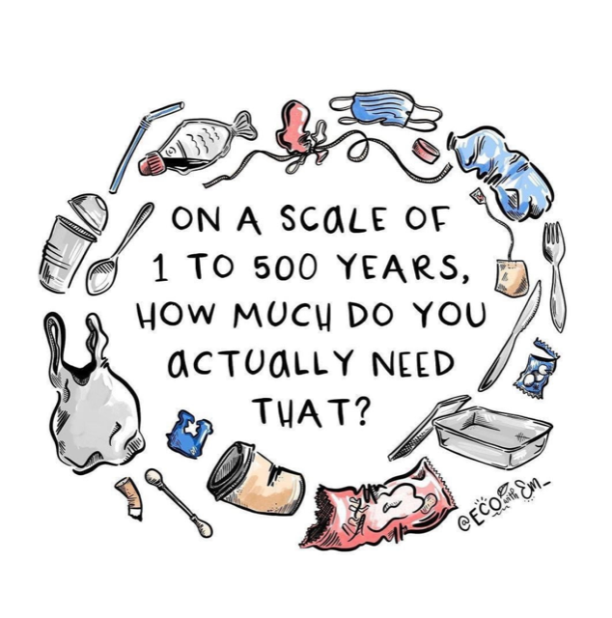
WHAT'S FASHION GOT TO DO WITH IT?
Notes:
How long it takes for things to break down… Big picture before specifics on clothing…

Slide 3

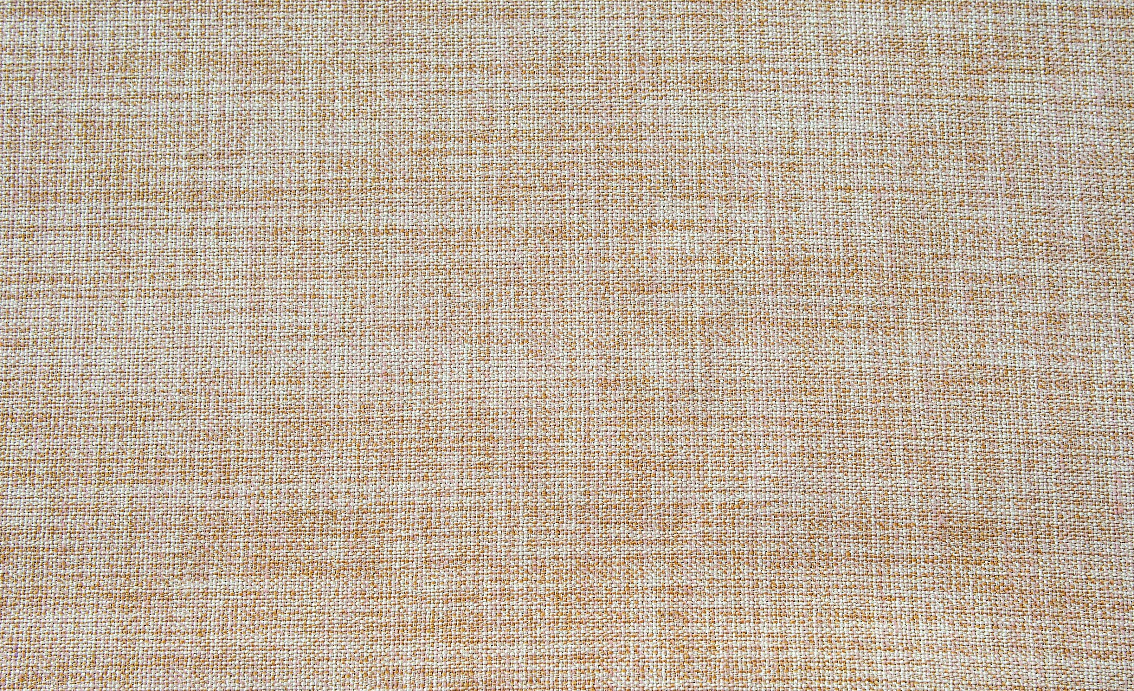
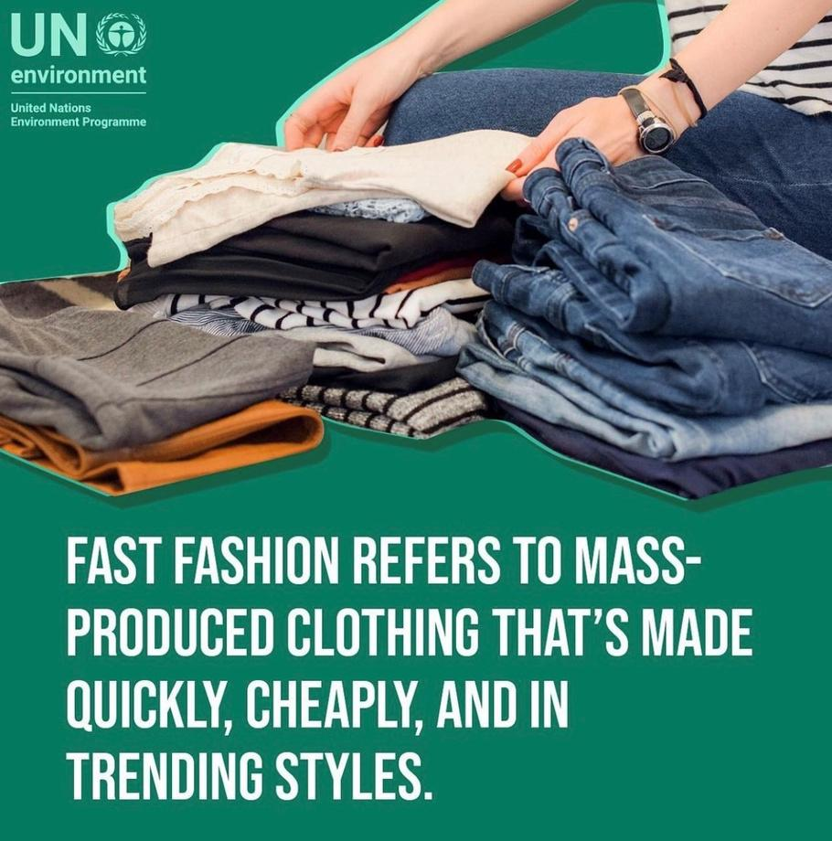
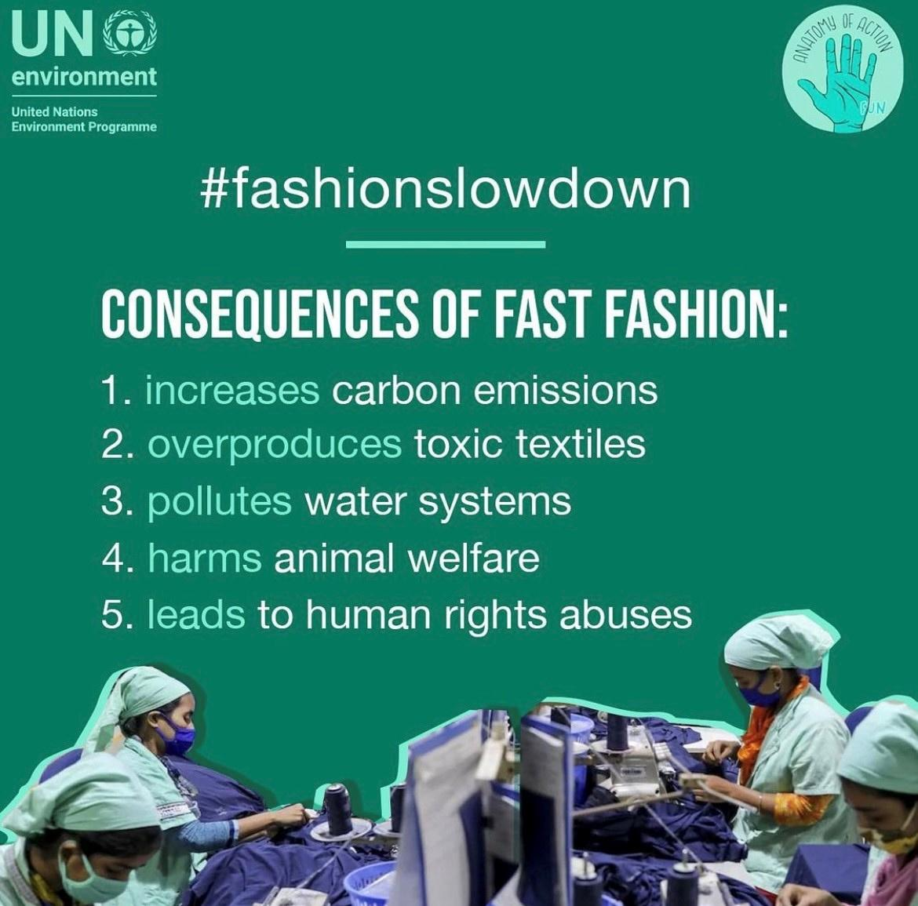


Slide 4

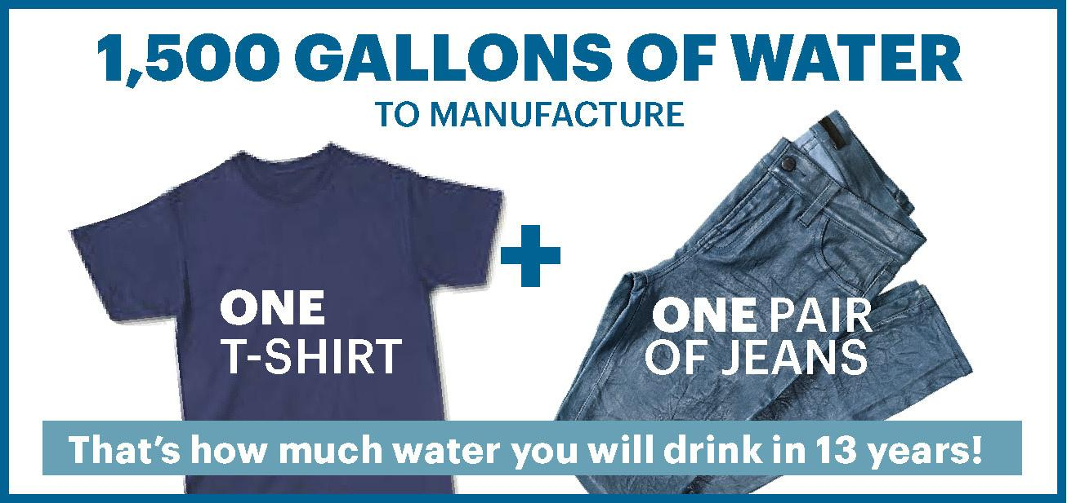


24,000

Slide 5
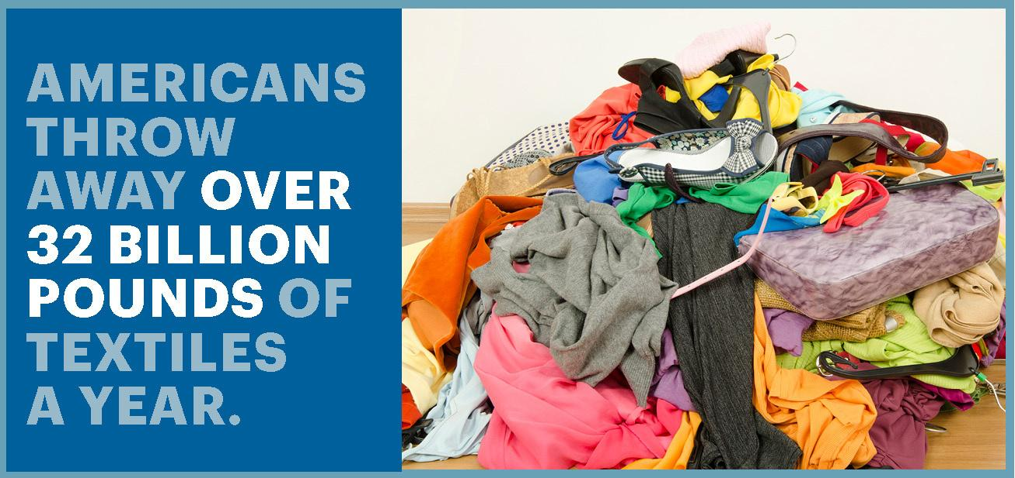
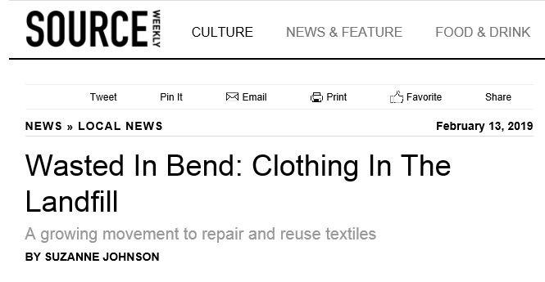
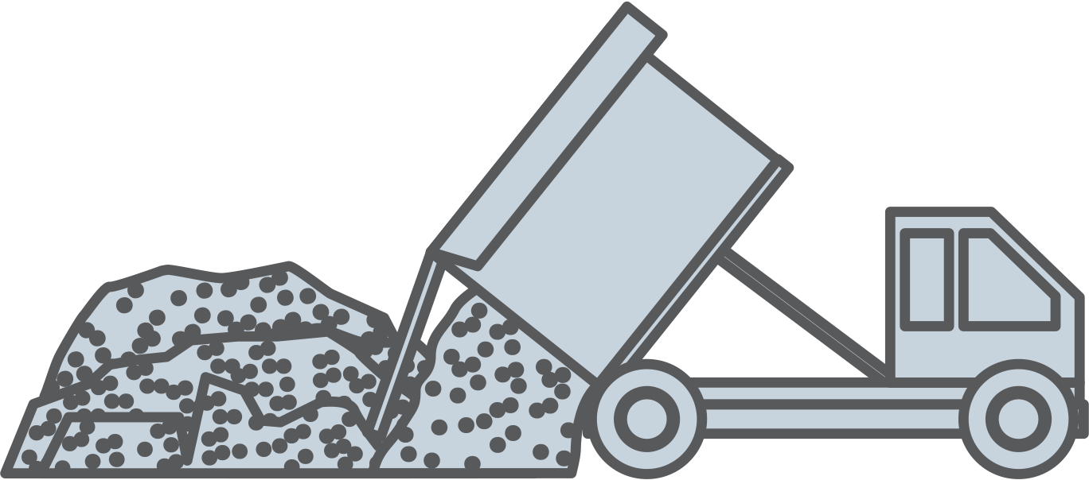

Notes:
Locally we have a clothing waste issue…that is why shopping second-hand (clothing connection) can divert textiles out of our local Knott landfill.

Slide 6
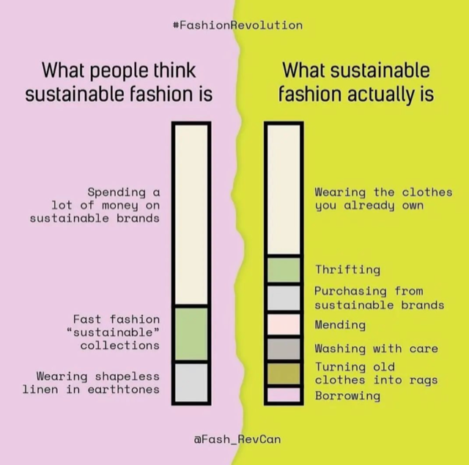

Slide 7







REFUSE
REUSE
SO, WHAT
CAN I DO?
CARE
MEND
UPCYCLE

Slide 8



REFUSE & REDUCE
Notes:
Refuse to purchase that item in the first place. Refuse to take part in human rights abuses and refuse to harm our environment. Then reduce the amount of clothing you purchase.

Slide 9





REUSE/BORROW/ LEND?!

Slide 10
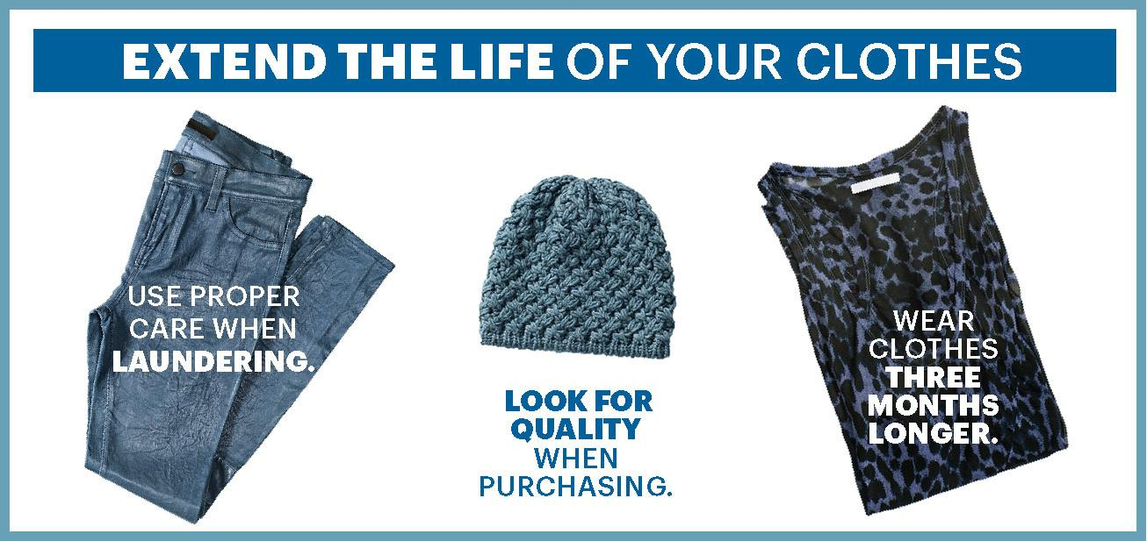


CARE
Notes:
Wash in cold. Air Dry. Read the garments label and care for it accordingly.

Slide 11
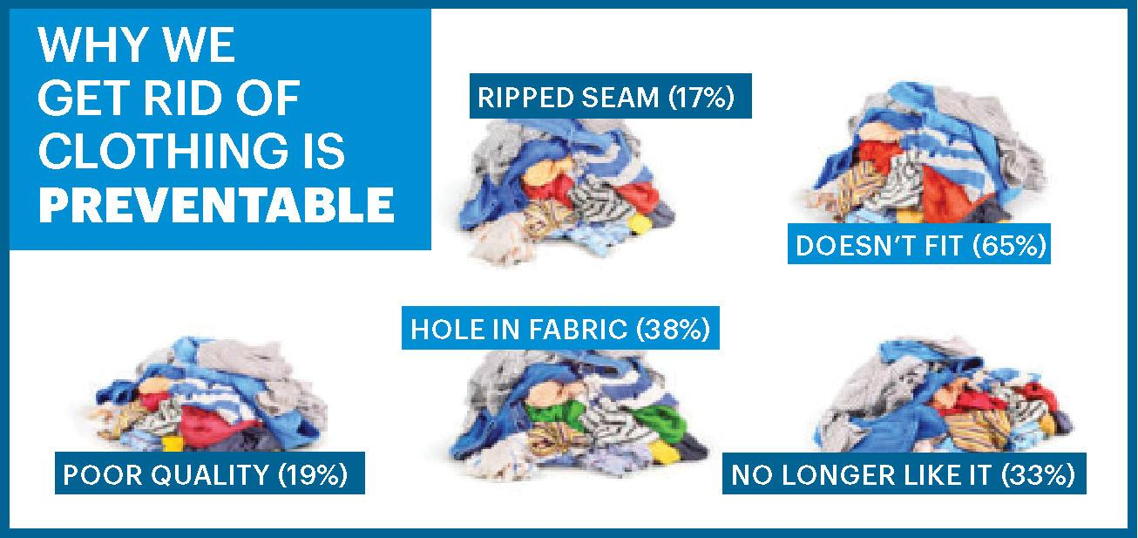

Slide 12


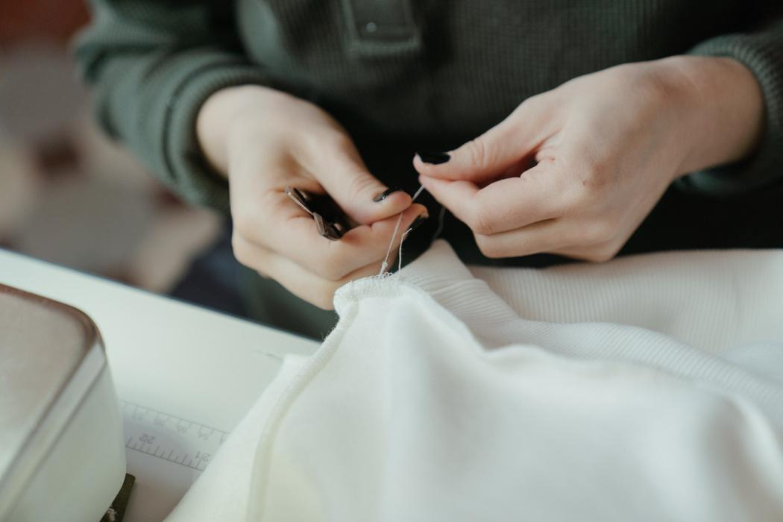

MEND
UPCYCLE
The Environmental
Center
Repair Café (4/26)
Maker Space
DIY Cave
RECYCLE
Notes:
Repair Café: at OSU-Cascades in partnership with The Environmental Center on 4/26 from 5:30pm-7:30pm (Clothing Connection-clothing exchange at the event)

Slide 13
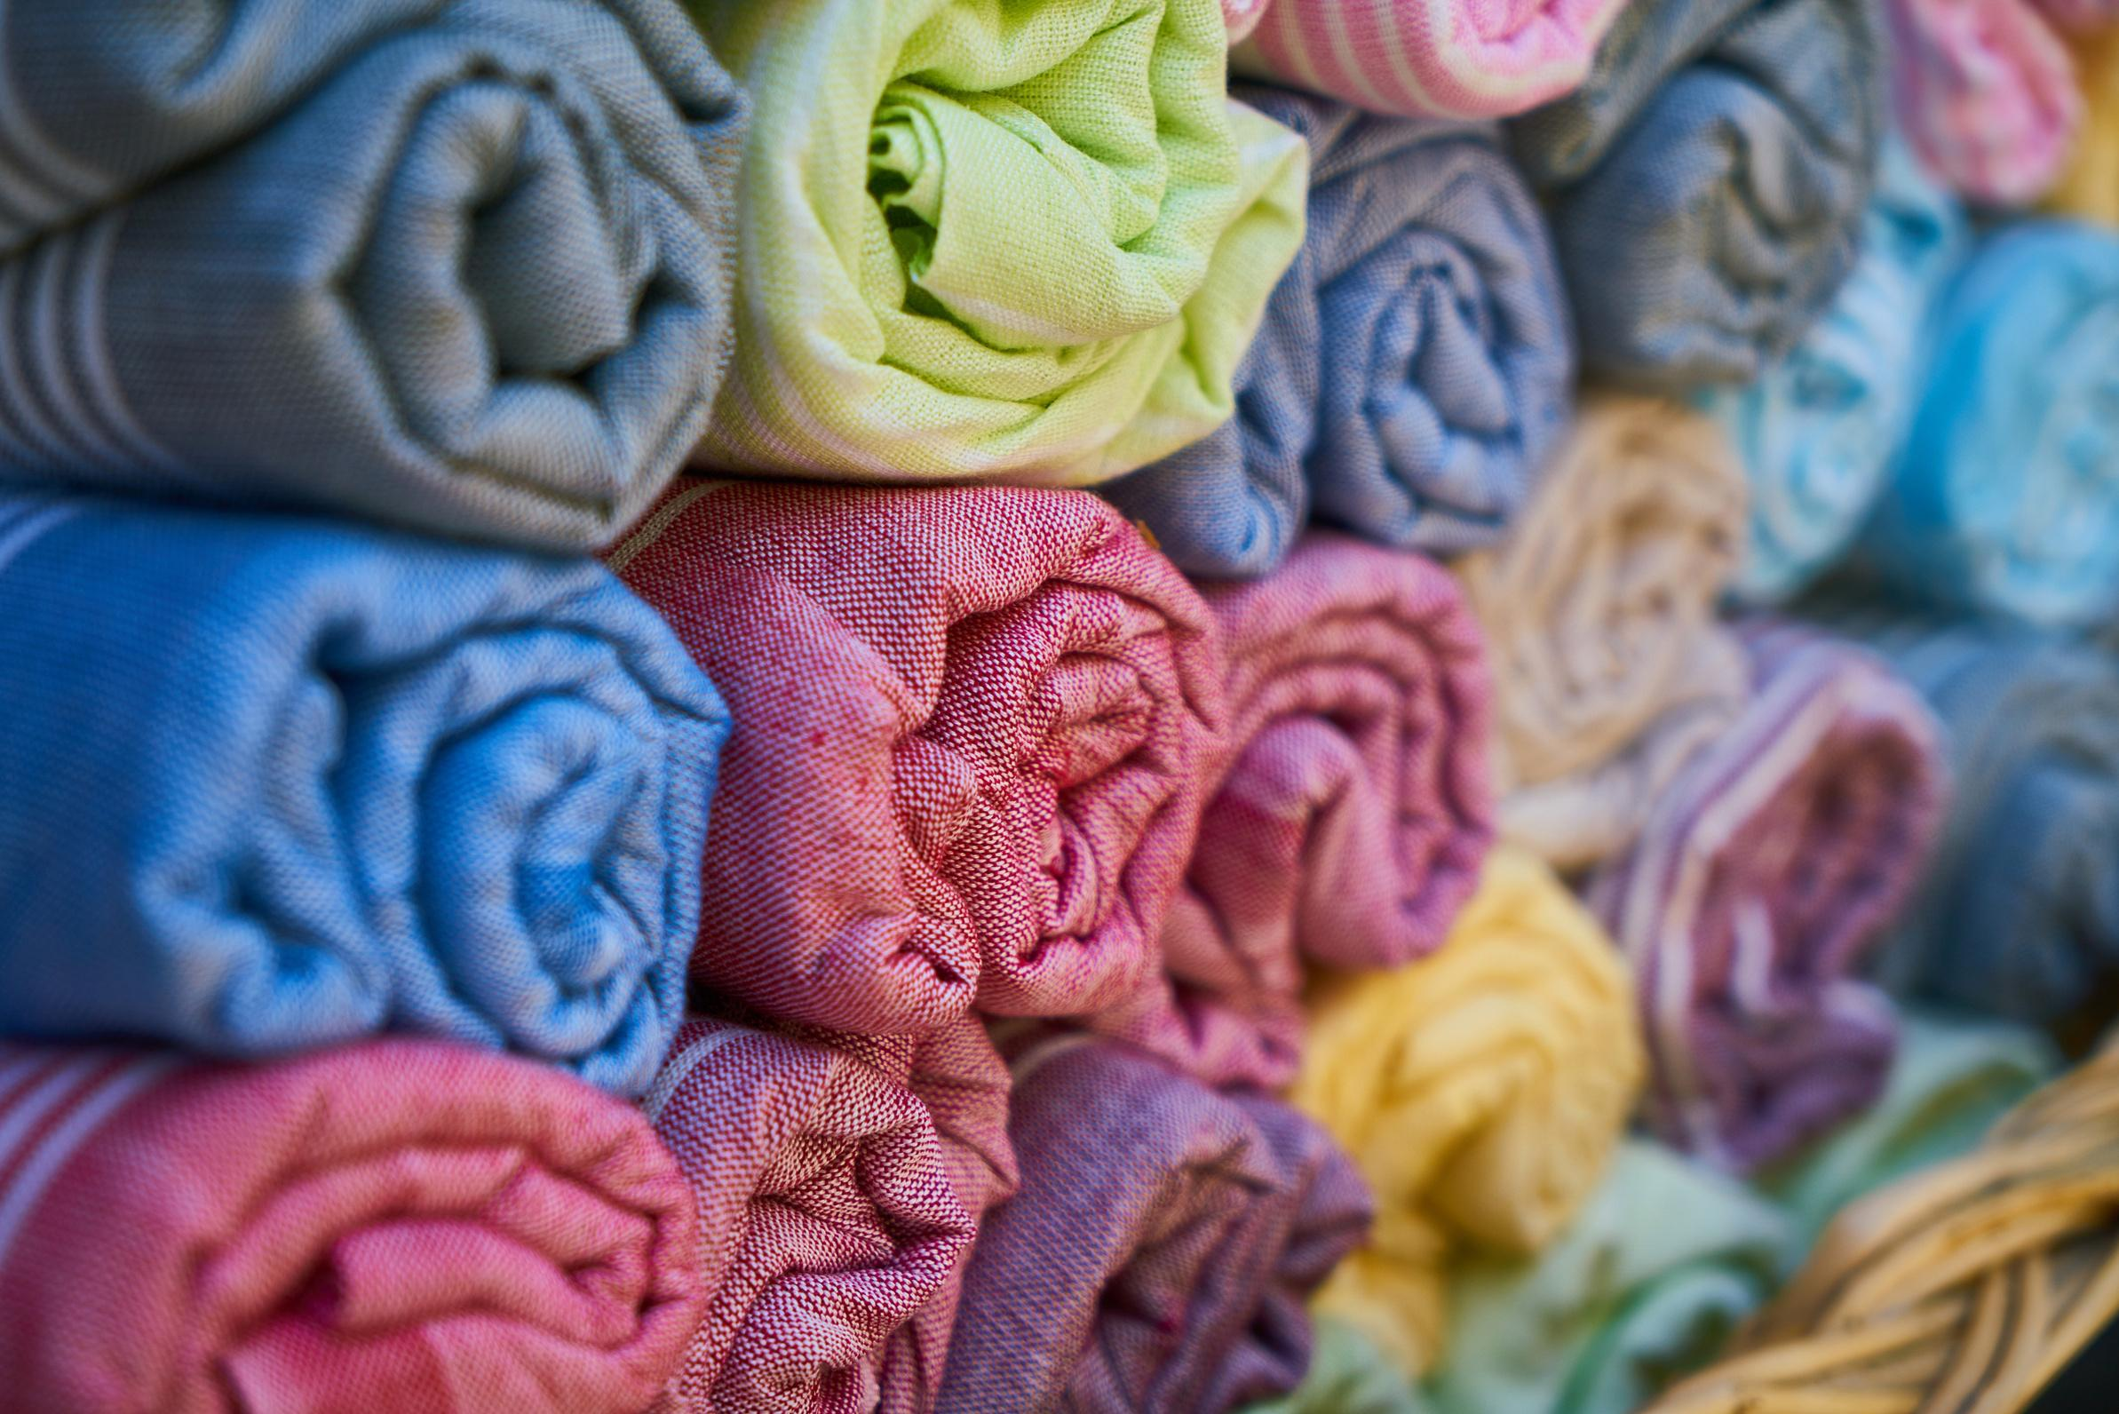

ORGANIC COTTON
Consumes less water, no GMO or chem
ORGANIC LINEN
Durable, biodegradable, little resources to grow
MODAL
Made from beech trees
HEMP
Fast-growing, little resources, antimicrobial
PEACE SILK
Produced from silkworm cocoons, but doesn't harm them like traditional methods
Wool
Biodegrades naturally
BAMBOO
Fast-growing, little resources, antimicrobial
Lyocell
Wood pulp, mainly from oak, birch, & eucalyptus trees
BEST FABRICS

Slide 14
“FAST FASHION IS NOT FREE. SOMEONE SOMEWHERE IS PAYING.”
- Lucy Siegle, journalist and author of books including To Die For: Is Fashion Wearing Out the World, and We Are What We Wear: unravelling fast fashion and the collapse of Rana Plaza

Slide 15
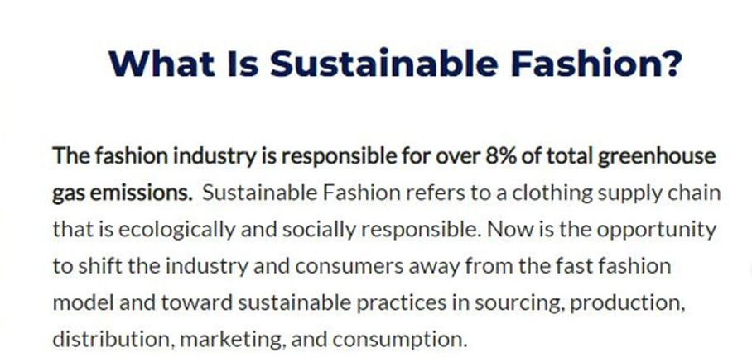
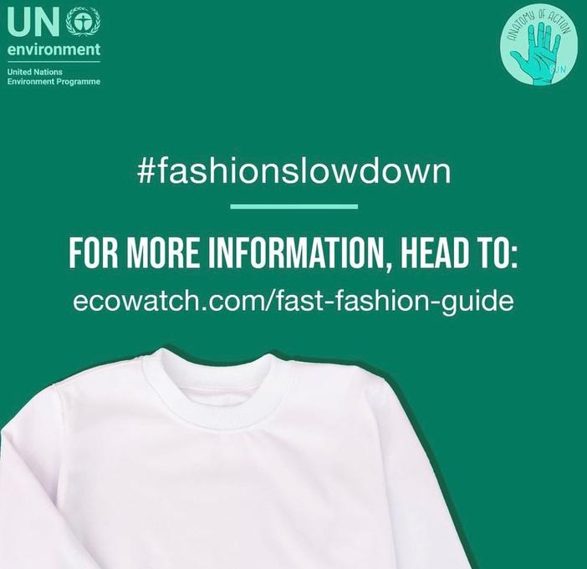
EARTHDAY.ORG
Notes:
Earthday.org has great tips on becoming more sustainable (fashion included).

Slide 16
Clothing Connection Stats.
Shirts/Sweaters: 258
Pants: 88
Skirts/Dresses: 48
Athletic/Outdoor: 28
Coats/Winter Gear: 59
Shoes: 29
Accessories/Other: 77
Total: 587 items
COCC: 105 students
OSU-C: 43 students
Notes:
October data, and we may be seeing more and more visitors as the word spreads. We think we are experiencing an increasing number of shoppers each month. This is saving students money and diverting clothing from the landfill.

Slide 17
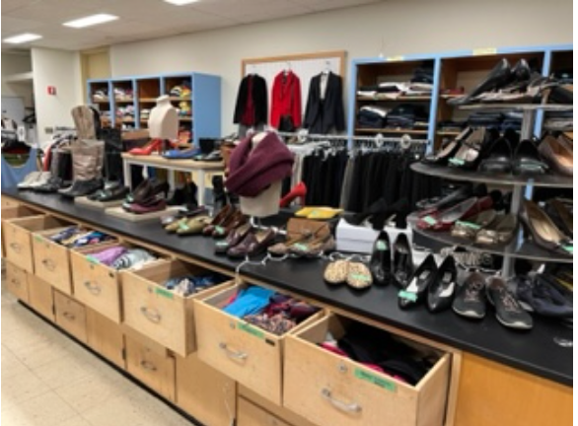
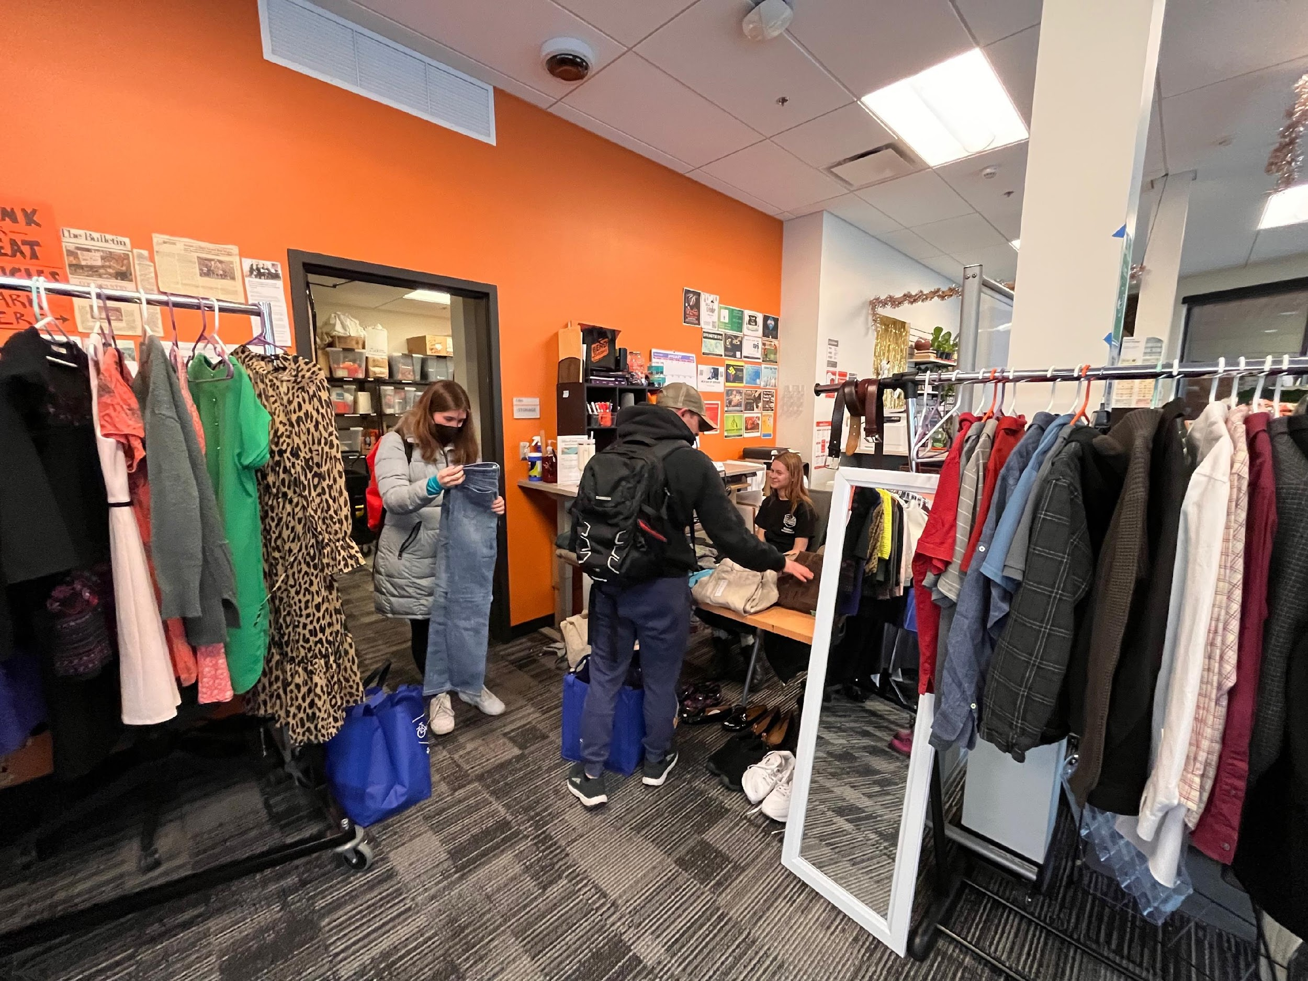
CLOTHING CONNECTION IS A FREE RESOURCE FOR COCC & OSU-CASCADES STUDENTS
COCC: Bend & Redmond campuses
OSU-Cascades: COCC Bend & Clothing Connection Monthly Pop-ups at OSU-Cascades

Slide 18
DONATION & GIVEAWAYS
DON’T FORGET TO STOP BY THE SUSTAINABLE FASHION TABLE!

Slide 19
Ben and Allison:
Fashion Show MCs

Slide 20
HAPPY ALMOST
THANK YOU!
Notes:
Thank you to the organizers, volunteers, and donors.

