Slide 1
Department & Program Review: Part II – DPR Report

Slide 2
A Quick Look Back

Slide 3
Foundational Principles
Meeting our Mission
Continuous Improvement
Inclusive
Provides Focus

Slide 4
Foundational Principles
COCC Plan, Goals & Improvements
Division Plan, Goals & Improvements
Unit Plan, Goals & Improvements
Department Plan, Goals & Improvements

Slide 5
Foundational Principles
Plan (three to five years)
Part 1: Mission
Part 2: Strategic Plan Connection
Part 3: Goals
Part 4: Activities
Part 5: Data
Report (annual)
Part 5: Data Findings
Part 6: Interpretation
Part 7: Action Plan

Slide 6
Report Basics

Slide 7
Keeping it Simple
The “What, So What, and Now What” Principle
What = Data
Now What = Data Interpretation
So What = Action Plan

Slide 8
Data with the Experts!

Slide 9
Institutional Effectiveness is here to help you!
Quantitative Data | Dashboards & More
Qualitative Data | Survey Landscape
Getting Started

Slide 10
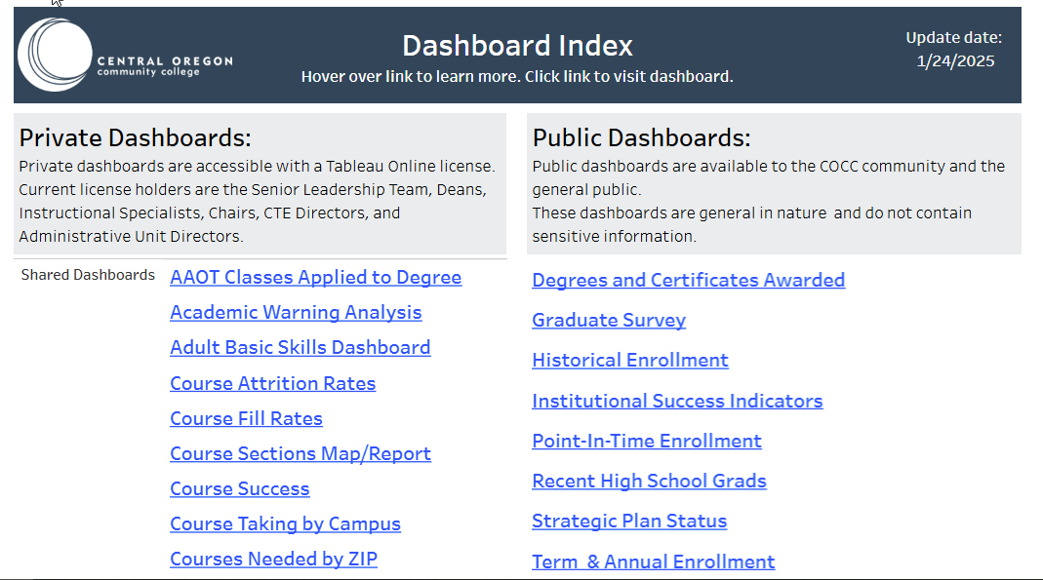
Quantitative Data
Notes:
Charts the course for the upcoming year or two

Slide 11
Qualitative Data
Graduation Survey - Annual
Student Campus Climate Survey – Every 3 Years
Great Colleges to Work For – Every 3 Years
COCC Student Engagement Survey – Annual
(in development)
Notes:
Charts the course for the upcoming year or two

Slide 12
Getting Started
Data interpretation is fun!
Determine the data you need long before you need it.
Reach out to Institutional Effectiveness for support… brainstorming, data interpretation, data collection options and more!

Slide 13
Breaking it Down: Data Findings
(DPR Part 5)

Slide 14
Data Findings
This one is easy:
Report the data.
Tables, charts, dashboard links – whatever best visually depicts the information.

Slide 15
Data Findings: Example 1
Office of Diversity and Inclusion
Outcome
Students feel safe, respected, and included at COCC as measured by College Climate surveys.
Data
79% of students responded that they felt comfortable or very comfortable with the overall climate at COCC.

Slide 16
Data Findings: Example 1
Office of Diversity and Inclusion
Outcome
Students feel safe, respected, and included at COCC as measured by College Climate surveys.
Data
79% of students responded that they felt comfortable or very comfortable with the overall climate at COCC.

Slide 17
Data Findings: Example 2
eLearning
Goal
5 or more faculty will be trained in standardized guidelines and
best practices for online courses and will pass an administered quiz at the end of training with a 90% score to ensure competency.
Data
This is scheduled for the next reporting period.
Notes:
You may have successes
You may have areas in which you didn’t meet your intended target
It’s a five-year plans, so you may not make progress immediately.

Slide 18
Breaking it Down: Data Interpretation
(DPR Part 6)

Slide 19
Data Interpretation Overview
Tell the story
Existing data versus future data needs
Don’t get caught in the data bog
Interesting versus relevant data
Use what the data tells you . . . even if you don’t like it

Slide 20
Team Time
“So What” factor
Interpret the data
Key takeaways
Write it on the flip chart (one page only)

Slide 21
Breaking it Down: Action Plan (DPR Part 7)

Slide 22
Action Plan Overview
What? So What? Now what?
Celebrate accomplishments
Initiate needed changes – aka, continuous improvement
Study further (but don’t get caught in a bog)
Revise assessment methods as needed
. . . and it’s all custom to what will be
useful for you and your team.

Slide 23
Action Plan: Don’t Overthink It!
Sound bites!
This is not a dissertation
Lay terminology
Actionable
Notes:
Charts the course for the upcoming year or two

Slide 24
Team Time
“Now what” factor
One to two year action plan
Focus on primary next steps:
  Accomplishments?
  Needed changes?
  Study further?
  Revise assessment methods?
Notes:
Charts the course for the upcoming year or two

Slide 25
Guess What? The DPR Report is done!

Slide 26
DPR Report Recap
Report
Part 5: Data Findings
Part 6: Interpretation
Part 7: Action Plan
Notes:
Charts the course for the upcoming year or two

Slide 27
DPR Report Recap
Duration: One to two years
Submitted: Annually (you determine when based on data availability)
Reviewed by: SLT Member or Dean
Word template, email . . . Whatever works best for you!
Notes:
Charts the course for the upcoming year or two

Slide 28
THANK YOU!
Stay and brainstorm with IE!

