Slide 1
Department & Program Review – Part I:
Overview and DPR Plan

Slide 2
The What & Why of Assessment

Slide 3
Foundational Principles
Meeting our Mission
Continuous Improvement
Provides Focus
Inclusive

Slide 4
Foundational Principles
And, oh – there’s the:
Accreditation Factor!
Notes:
The carrot vs. the stick

Slide 5
Foundational Principles
COCC Plan, Goals & Improvements
Division Plan, Goals & Improvements
Unit Plan, Goals & Improvements
Department Plan, Goals & Improvements

Slide 6
Foundational Principles
COCC Plan, Goals & Improvements
Division Plan, Goals & Improvements
Unit Plan, Goals & Improvements
Department Plan, Goals & Improvements

Slide 7
DPR Overview
Notes:
Pop Quiz – what does DPR stand for?

Slide 8
DPR Overview
Plan (three to five years)
Part 1: Mission
Part 2: Strategic Plan Connection
Part 3: Goals
Part 4: Activities
Part 5: Data
Report (annual)
Part 5: Data Findings
Part 6: Analysis
Part 7: Action Plan
Notes:
Mission: What are we doing ?
SP Connection: Why are we doing it?
Goals: What are we trying to improve?
Activities: How are we going to do it?
Data: How well are we doing it (future tense)
Data Findings: What the data told us (past tense)?
Data Analysis: What we learned
Action Plan: How are we using the information to improve?

Slide 9
DPR Overview
Goals
Act
Activities
Mission
Analyze
Measure
Notes:
For those who like more circular, more friendly looking approaches…

Slide 10
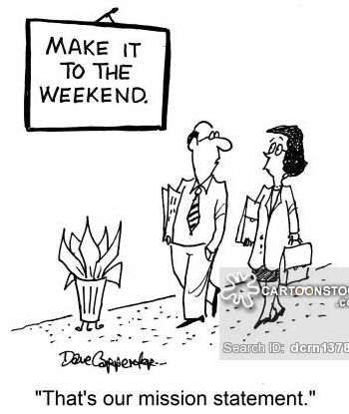
Breaking it Down: Mission (DPR Part 1)

Slide 11
Mission Statement
Aligns with Division mission
Includes the who, what and why
Long-lasting (+/- ten years)
Provides long-term focus for the department
Realistic
Lay language
Succinct: 25 words or less!

Slide 12
Examples
XYZ’s IT Department recommends, implements, and maintains technologies to support a high-quality learning and work environment for our students and employees.
XYZ college’s Physical Plant team creates and supports a safe and well-maintained campus and provides the highest quality service.
XYZ’s Fiscal Management Office is a collaborative partner to the college community, serving as a steward of financial assets and supporting employees with budget management needs.
Notes:
Identify the who, what and why . . .

Slide 13
Team Time
Aligns with Division mission
Includes the who, what and why
Long-lasting (+/- ten years)
Provides long-term focus for the department
Realistic
Lay language
Succinct: 25 words or less!

Slide 14
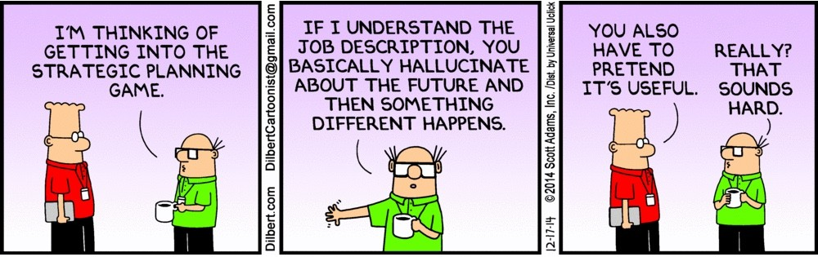
Breaking it Down: Strategic Plan Connection (DPR Part 2)

Slide 15
Strategic Plan Connection
Pop Quiz!
COCC Strategic Plan

Slide 16
Strategic Plan Connection
Choose 1 – 3 strategic plan goals that most closely align with your department’s work.
No more, no less.

Slide 17
Strategic Plan Connection
Student-Ready College
Access
Community Engagement
Workforce Development
College Sustainability

Slide 18
Team Time

Slide 19
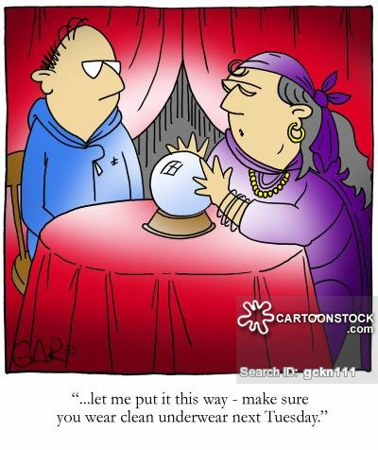
Breaking it Down: Department Goals (DPR Part 3)

Slide 20
Goals vs. Outcomes
 | Goals | Outcomes
Provides focus for the shorter term (3 – 5 years) | √ | √
Focuses on continuous improvement | √ | √
Achievable | √ | √
Measurable | √ | √
Orientation | Service | Learning
Language | Active or process focus | Bloom’s Taxonomy
Notes:
Cont improvement: Moves the needle on department effectiveness

Slide 21
Goals vs. Outcomes: Definition
Goal: Describes what your department wants to achieve within a specific timeframe. Often are service-oriented.
Outcome: What you want your customer to know, think or do as a result of your work.

Slide 22
Goals vs. Outcomes: Examples
Goal: Provide accurately and timely reports to college administrators.
Outcome: College administrators will have the financial information needed to make operational and strategic decisions.

Slide 23
Goals vs. Outcomes: Examples
Goal: Provide employees with ready access to professional development opportunities.
Outcome: Employees will express that professional development opportunities meet or exceeds expectations.

Slide 24
Goals vs. Outcomes
And the best part?
You get to pick.
What has the most meaning for your department?

Slide 25
Team Time
 | Goals | Outcomes
Provides focus for the shorter term (3 – 5 years) | √ | √
Focuses on continuous improvement | √ | √
Achievable | √ | √
Measurable | √ | √
Orientation | Service | Learning
Language | Active or process focus | Bloom’s Taxonomy

Slide 26
Breaking it Down: Activities (DPR Part 4)

Slide 27
Activities
Aligns with goals.
The “things” you will do to achieve your goal.
Checklist item. When done, it’s done (although its impact or action may continue).
Not an exhaustive list!
Shorter focus, achievable in one to two years.

Slide 28
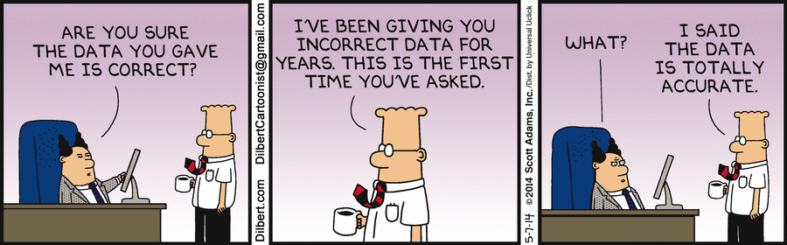
Breaking it Down: Measurement
(DPR Part 5)
Notes:
Chris E credit for the joke

Slide 29
Data and Targets
Measures goals, not activities
Accessible
Valid
Effective
Simple
Timing
Notes:
Quantitative or qualitative
Accessible: Data already exists and/or is easy to collect? Just a hint: Can you tie it to any SP indicator?
Valid: Measures what you intend it to measure
Effective: Not just counting everything that moves
Simple: Don’t overcomplicate it. Not giant statistical analysis needed (Brent story).
Timing: Get it on a calendar and pick the timing that works best for you.

Slide 30
Data and Targets
What you are going to measure
Intended target
When you are going to measure it
Using what tool
Notes:
Quantitative or qualitative
Accessible: Data already exists and/or is easy to collect? Just a hint: Can you tie it to any SP indicator?
Valid: Measures what you intend it to measure
Effective: Not just counting everything that moves
Simple: Don’t overcomplicate it. Not giant statistical analysis needed (Brent story).
Timing: Get it on a calendar and pick the timing that works best for you.

Slide 31
Data and Targets: Examples
The conversion rate for admitted students will increase by 2% per year over the duration of this plan. This will be measured in spring of each year using Banner data.
Notes:
Quantitative or qualitative
Accessible: Data already exists and/or is easy to collect? Just a hint: Can you tie it to any SP indicator?
Valid: Measures what you intend it to measure
Effective: Not just counting everything that moves
Simple: Don’t overcomplicate it. Not giant statistical analysis needed (Brent story).
Timing: Get it on a calendar and pick the timing that works best for you.

Slide 32
Data and Targets: Examples
The conversion rate for admitted students will increase by 2% per year over the duration of this plan. This will be measured in spring of each year using Banner data.
Notes:
Quantitative or qualitative
Accessible: Data already exists and/or is easy to collect? Just a hint: Can you tie it to any SP indicator?
Valid: Measures what you intend it to measure
Effective: Not just counting everything that moves
Simple: Don’t overcomplicate it. Not giant statistical analysis needed (Brent story).
Timing: Get it on a calendar and pick the timing that works best for you.

Slide 33
Data and Targets: Examples
Students using Inclusive Access during the first week of class will grow by 5% annually, as measured by online purchasing data each spring.
What? Target? When? How?
Notes:
Quantitative or qualitative
Accessible: Data already exists and/or is easy to collect? Just a hint: Can you tie it to any SP indicator?
Valid: Measures what you intend it to measure
Effective: Not just counting everything that moves
Simple: Don’t overcomplicate it. Not giant statistical analysis needed (Brent story).
Timing: Get it on a calendar and pick the timing that works best for you.

Slide 34
Team Time
What you are going to measure
Intended target
When you are going to measure it
Using what tool

Slide 35
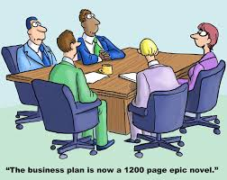
Guess what? The DPR Plan is done!
Notes:
Chris E credit for the joke

Slide 36
DPR Plan Recap
Plan
Part 1: Department mission statement
Part 2: Strategic plan goal connection
Part 3: Department goals
Part 4: Department activities supporting goals
Part 5: Measurement (what, how and when)

Slide 37
DPR Plan Recap
Duration: Three to five years, but . . . you can update if major initiatives change your course.
Submit to your SLT member for review and feedback by mid-spring term.
Word template.
And you have support!

Slide 38
DPR Plan Recap
No novels!
No dissertations!
Short and simple!
(please)

Slide 39
Department & Program Review: Part I - Plan:
Questions?

Slide 40
Department & Program Review:
What’s Next?

