Slide 1

Strategic Course Scheduling
Annemarie Hamlin, VPAA
Jessica Giglio, Instructional Dean
Cindy Lenhart, Instructional Outreach Dean
COCC Board Presentation, September 11, 2024
Notes:
Annemarie

Slide 2
Strategic Plan Action Project
Develop a student-centered, comprehensive, year-long schedule of classes for all four campuses.
Notes:
Annemarie

Slide 3
Connection to Strategic Plan Goals
Student-ready College: Strategic scheduling helps the College address diverse student needs through large-scale planning
Access: Students at all four campuses and online can plan and progress through their programs
Notes:
Annemarie

Slide 4
Our Work So Far
Three-Year Process
  Year 1 (2022-23): Research and planning
  Year 2 (2023-24):
    Redesigned key processes/policies
    Developed 2024-25 year-long schedule of classes
    Began set up of new CLSS scheduling software tool
Notes:
Cindy

Slide 5
Where Are We Today?
Year 3 (2023-24):
  Train faculty and staff on CLSS tool
  Put CLSS tool into production to develop 2025-26 schedule of classes
  Continue to refine processes
Notes:
Cindy –

Slide 6
Who Is Involved?
Strategic Scheduling Team: cross-sectional group from
  Academic Affairs
  Information Technology Services
  Student Services
  Branch campuses
Other key players: over 90 faculty and staff
Notes:
Jessica

Slide 7
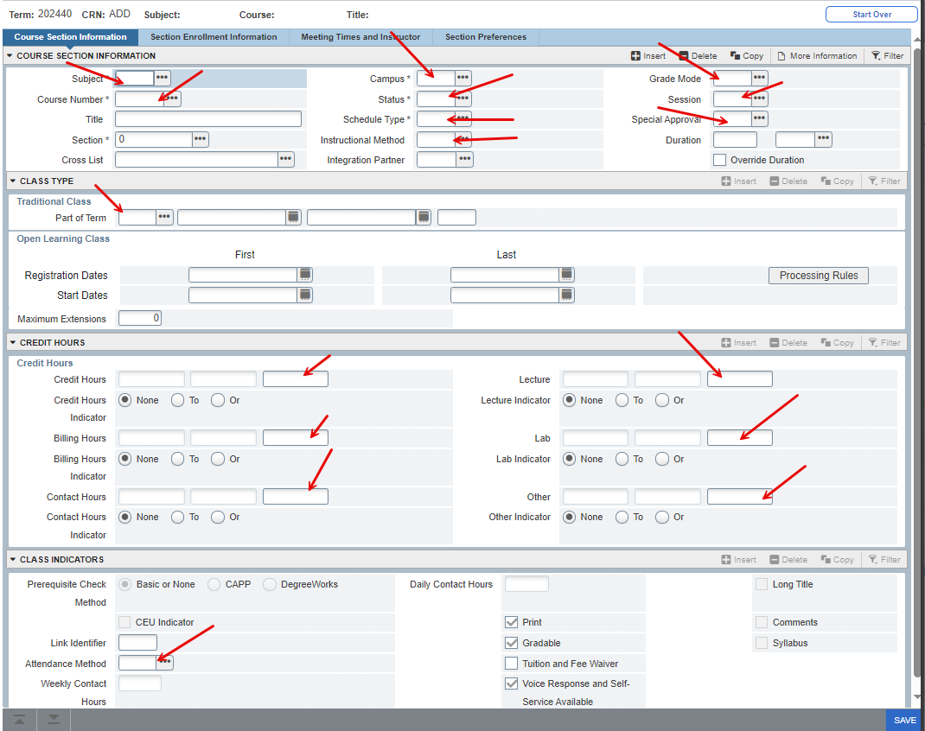
CLSS Tool vs Banner: Banner Setup
Notes:
Jessica

Slide 8
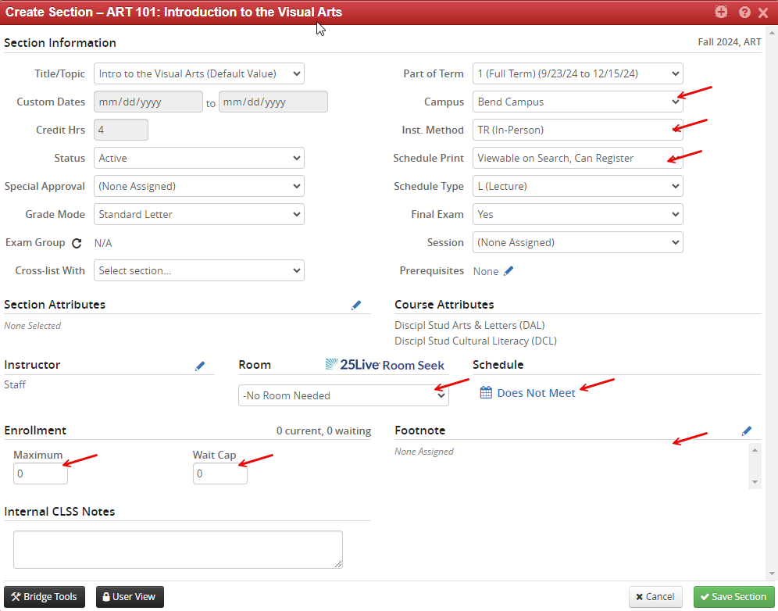
CLSS Tool vs Banner: CLSS Setup
Notes:
Jessica

Slide 9
Benefits For Schedulers
Workflows: approvals are easy to track
Guardrails: less room for error
Pre-sets: meeting patterns and class start times automatically populate
Reporting: easily digestible visuals give a big-picture view of the schedule for each term
Shared access: schedulers can view courses across departments
Notes:
Jessica

Slide 10
Benefits For Students
  Reliable schedules to help them plan
  Standardized times and delivery methods for classes so student know what to expect
  Fewer schedule conflicts because of interdepartmental communication and collaboration
  Ability to progress in their degrees due to holistic schedule planning
Notes:
Cindy

Slide 11

Questions?

