Slide 1
‘23-27 Strategic Plan Connection
  Goal: Student-Ready College
  Assessment: Credit momentum
  Writing and math course completion
  First-term and first-year retention
  Graduation rates
  . . . All disaggregated by various
  demographic factors
Notes:
How are we measuring our progress to our Student Ready College goal?
Credit momentum, by which we mean how many credits students are taking in their first term and first year and whether they are continuing on their path
Completion of college-level math and writing course requirements within the first year
How well we are retaining students from the first term to the second and first year to the second
How many students have completed their stated goals

Slide 2
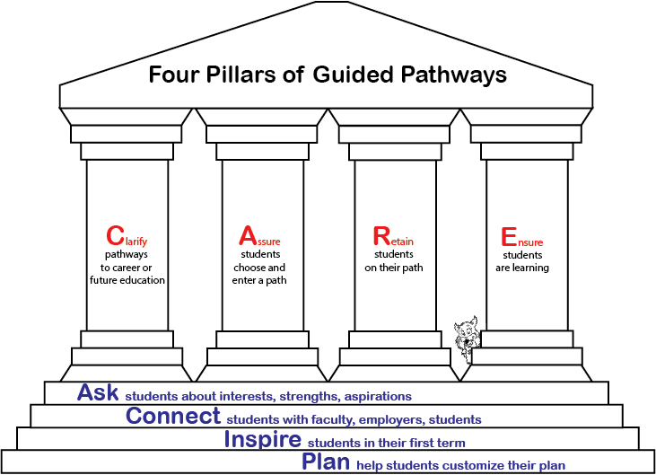
Guided Pathways, 2.0
Notes:
The original Guided Pathways philosophy of creating paths and helping students stay on those paths to successful completion and verified learning still forms a foundation for our work, but we are really building our work around the principles of
Guided Pathways 2.0:
1): ASK: How, when and how often do we intentionally and formally ask students about their goals, interests, and aspirations?
2) CONNECT: How and when do we connect students with potential employers, faculty mentors, peer students?
3) INSPIRE: How do we inspire students in their first term courses?
4) PLAN: How do we help students develop a plan to reach their goals?

Slide 3
2023 - 24
  Implementation Teams
    Admitted Student Communications
    New Student Onboarding
    Academic Advising and Career Services
    New Student Orientation
    Trailhead Courses
Notes:
In last year’s work, work groups were charged with proposing action items with which we would build our multi-year implementation plan.
This year that the teams are putting those plans into useable form that will shape our work:
How and when we communicate with newly admitted students (well before they start classes) about our pathway options, asking about their interests and connecting them to resources related to the pathways
How we work with new students once they have decided that they will be Bobcats to get them set up for success in their pathways, also incorporating elements of the ACIP model
How we continue (through faculty and professional advisors) to ask about students interests, connect them to the right resources, and plan how they will navigate their education pathways
How we reshape our new student orientation around the various pathways so that we have strong elements of ask, connect, inspire, and plan shortly before they begin taking classes at COCC
How we design or redesign courses that they would take early in their time at COCC that can ignite their enthusiasm and begin their education pathway with strong elements of connection to their educational experience.

Slide 4
Education Pathways at COCC
Science, Technology, Engineering and Math
Social Science, Behavioral Science, and Education
Health Sciences
Natural Resources
Transportation, Industrial Trades, and Apprenticeship
Humanities, Fine Arts and Communication
Business, Hospitality and Culinary
Public and Emergency Services
Notes:
Just over two years ago, one of the early planning groups developed these eight educational pathways and determined which disciplines would be in them. As we move toward our ultimate launch date, we will do continual reflection and tinkering with the disciplines that are grouped under each of these titles.
That was just one part of the prep work we have done and are doing, and Alicia will share more about some of our current work.

Slide 5
Implementation
Prep Work
Winter 2024 – Fall 2025
Student Information System Redesign
New Admissions Application Implementation
Data Crosswalk Development
Begin Web Redesign Discussions
Adjust External reporting
Employee Trainings
Catalog and Curriculum Alignment
Notes:
Alicia’s slide

Slide 6
Implementation
Phase 1
Spring 2025
Summer 2025
Fall 2025
Preview Days
Admitted Student Communications
Advising & Registration
Bobcat Orientation
Trailhead Courses
Notes:
We are going with a two-phase approach to this work, which—as you can imagine—has many moving parts.
Preview days (for high school students) will help students understand the paths and get them thinking about which path they will choose.
Throughout the summer, staff will be communicating with and advising students using the ACIP principles.
Bobcat Orientation and Trailhead courses will be built around the eight pathways. We expect to launch at least some of those courses in phase 1.

Slide 7
Implementation
Phase 2
Winter 2026
Summer 2026
Fall 2026
Phase 1 Review and Process Improvement
Prospective Student Materials
Website Redesign
Full Launch
Notes:
In Winter of 26, we will take stock of our work in phase one and look for areas to improve and tighten up our work.
In summer, we will have materials ready for prospective students and our website will reflect the education pathways orientation of the College.
In fall 2026 we are planning for the full launch of our pathways and then we continually measure our success and improve our work based on what we learn.

