Slide 1

Guided Pathways

Slide 2
Getting Started
Find Your Peeps!
(aka, get in your Ask, Connect, Inspire, Plan group)
Notes:
Alicia

Slide 3
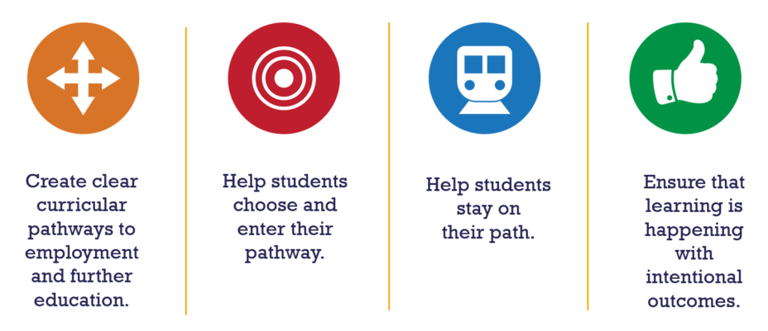
Guided Pathways, 1.0
Notes:
The original Guided Pathways model: 1) How do we develop clear pathways to a career or transfer, 2) How do we help students choose a pathway, 3) How do we help them stay on the path, and 4) how do we ensure students are learning?

Slide 4
Guided Pathways, 1.0
Early Momentum Metrics
What percentage complete 12 or more credits their first term?
15%
What percentage complete 36 or more credits their first year?
8%
Notes:
GP 1.0 was grounded in a concept called “early momentum metrics” – in other words, how quickly are students progressing through their classes towards a career or transfer? It evaluated first-time in college students and guess what?
Their “momentum” isn’t very strong (note: click to get the first question and give the group time to respond; click for the answer. Repeat with second question).

Slide 5

Guided Pathways, 1.0
Enter Guided Pathways, 2.0
Notes:
WE definitely need to do better by our students – it’s not their job, it’s our job. We need to shift our mindset from expecting students to be college-ready and instead, expect ourselves to be student-ready.

Slide 6


Guided Pathways, 2.0
Notes:
The new model: Ask – Connect – Inspire – Plan sit across the four Guided Pathways pillars and asks US to be ready to support students at all phases of their time at COCC (next slide).

Slide 7
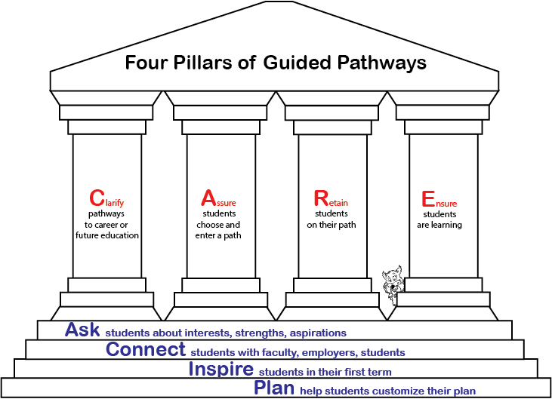
Guided Pathways, 2.0
Notes:
Guided Pathways 2.0:
1): ASK: How, when and how often do we intentionally and formally ask students about their goals, interests, and aspirations?
2) CONNECT: How and when do we connect students with potential employers, faculty mentors, peer students?
3) INSPIRE: How do we inspire students in their first term courses?
4) PLAN: How do we help students develop a plan to reach their goals?

Slide 8
Guided Pathways, 2.0
COCC’s top 10 programs
Undecided
Notes:
With this, GP 2.0 looks at students’ majors and first term course taking patterns – in addition to the early momentum metrics.
Click once and ask the group: What do you notice about COCC’s “top 10” programs?
Click again? The vast majority of first-time COCC students are in “undecided” types of majors. Uh oh – how do we help these students get on a path, be inspired and develop a plan? Guess what? Here comes GP 2.0!
Next slide?

Slide 9
Guided Pathways, 2.0
Exploratory Students: First Term
Rank | Course | # Program Students | % Program Students
1 | WR 121: English Comp | 48 | 32%
2 | HD 100CS: College Success | 47 | 31%
3 | MTH 95: Inter. Algebra | 18 | 12%
4 | MTH 111: College Algebra | 18 | 12%
5 | SP 111: Public Speaking | 13 | 9%
6 | WR 65: Rhet/Crit Thinking II | 11 | 7%
7 | SP 218: Interpersonal Comm | 11 | 7%
8 | HHP 185: Weight Training | 9 | 6%
9 | BA 101: Intro to Business | 9 | 6%
10 | HD 110: Career Planning | 9 | 6%
>10 | 121 other courses
Notes:
This slide shows the typical course taking patterns. What do you think?
Click so the “Boring” shows up.

Slide 10
Guided Pathways: COCC
Notes:
Oi la! But what does Guided Pathways look like at COCC? It is more than just “meta-majors.” This is where you come in! Your opinion is important to us – we need your feedback to develop COCC’s Guided Pathways plan. How will we ASK students about their goals, how will make them feel CONNECTED to COCC, how will we INSPIRE them their first term, and how will we help them develop a PLAN to reach their goals?
COCC’s next steps with GP is to develop a three- to five-year GP plan. What activities and initiatives will help our students? How will Ask, Connect, Inspire, and Plan with them? Think broadly and don’t be constrained by current processes.
GP Steering Team reviewed best practices for GP ACIP activities and narrowed a giant list down to a few key initiatives within each aspect of the ACIP model. Now is your time to help the Steering Team prioritize that list and develop a long-range plan to implemented the initiatives, whether they are new – or in many cases, redesigning how we do things currently.
To help with this, we’ll break you into teams…CLICK to next slide.

Slide 11

Step 1: Three Pairs
Ask
Connect
Inspire
Plan
Notes:
Break into three pairs within each group; adjust as needed if even numbers are not possible.

Slide 12
Step 1: Prioritize Initiatives in Pairs
Key Question:
Which initiatives have the greatest potential to positively impact student success?
(10 minutes)
Notes:
Pairs have ten minutes max to review the initiatives and prioritize from highest priority to lowest priority. They should NOT write on the cards.

Slide 13
Step 2: Group Up
Ask
Connect
Inspire
Plan
Notes:
Each group comes back together.

Slide 14
Step 2: Prioritize Initiatives in Team
11 points
11
6
3
0
3
3
0
0
5
0
2
0
0
0
0
Notes:
10 minutes for this explanation and time to prioritize.
Goal for this next phase is to review how the pairs prioritized the initiatives. Then, as a group, they need to prioritize the initiatives by assigning a point value. Each group has 11 points to award across all initiatives. Distribute points according to how you want to weight initiatives; can assign 0 points as desired. Show examples on slide 14.

Slide 15
Step 2: Prioritize Initiatives in Teams
11 points
Which initiatives have the greatest potential to positively impact student success?

Slide 16
Step 3: Speed Share
Share Your Priorities
(1 minute)
Notes:
Each group has ONE MINUTE to share the total number of points assigned to their initiatives and explain why they rated their top initiative as they did.

Slide 17
What’s Next
Ask – Connect – Inspire – Plan
Not the first bite at the apple.
Get involved!
ACIP article
Short break – return to this room
Strategic Planning
Notes:
Wrap up:
Not the first bite: Information from this breakout session will help the Guided Pathways Steering Team develop a 5’ish year plan for implementing GP initiatives. But this will not be your only opportunity to provide feedback and we hope to have draft 1.0 for your review in mid-winter quarter.
Get involve: The plan will provide a lot of opportunity to get involved so if you’re interested early on, please contact Annemarie
ACIP article: We will post the results of this breakout session, along with a research report detailing the ACIP model, to Headlines shortly after the start of the year.
Short break: Don’t go far because you’re coming back here for the next breakout session – and it’s all about strategic planning. Therefore, what did you learn today that might carry forward to our next SP?
Strategic Plan: More time for your feedback. Where do you want to see COCC grow in the coming years?

